Slide 1

Supporting Your Business
Southern Lancaster County Chamber
04/09/26

Slide 2

Takeaways
Who is the Workforce Development Board?
Partners in the talent attraction/retention strategy
Resources to your company

Slide 3
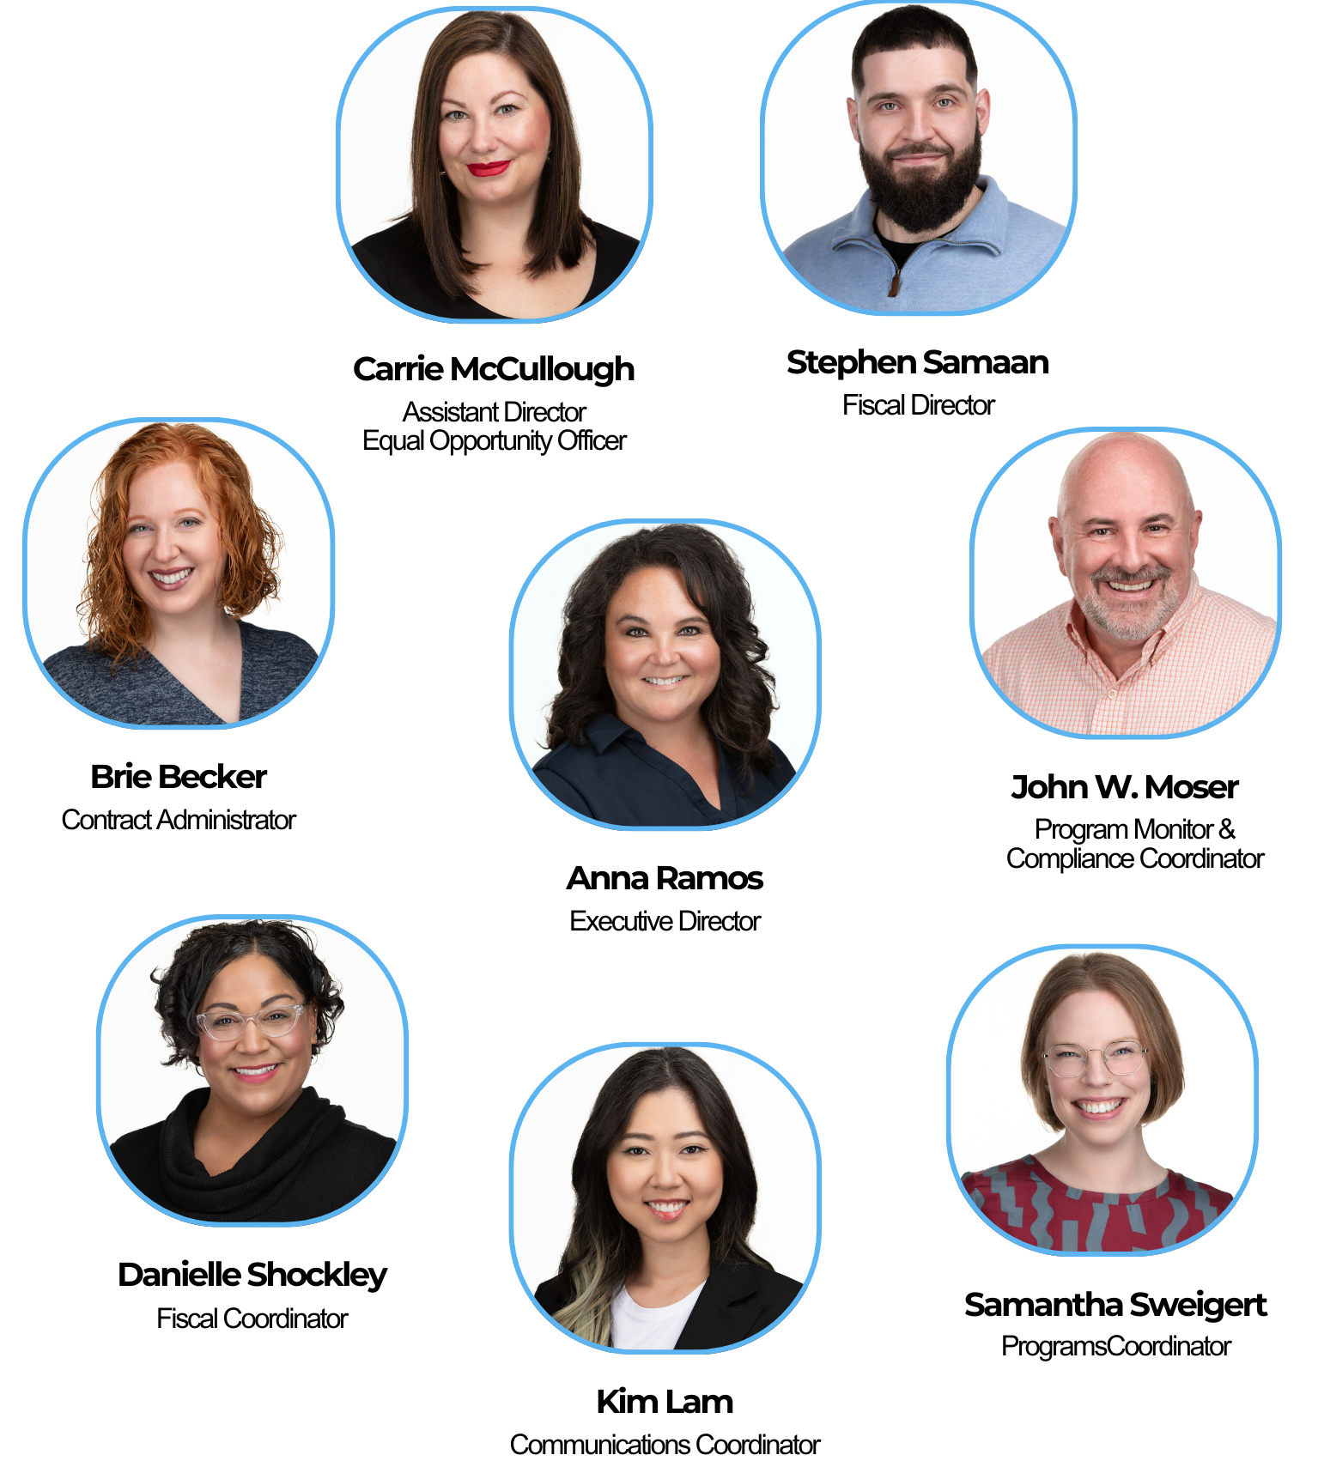

ABOUT US
LANCASTER COUNTY
WORKFORCE
DEVELOPMENT BOARD
MISSION
To lead the workforce development ecosystem by aligning fiscal and educational resources to support Lancaster County jobseekers and businesses.
VISION
A Lancaster County that fosters innovation, equity, and opportunity for all that creates measurable economic mobility.

Slide 4
The Changing Landscape of Workforce
566,047
County Population
64.9%
Labor Participation Rate
2.7%
Unemployment Rate
8.1%
Employment Rate
Notes:
Lancaster County is not facing a job shortage—we are facing a workforce constraint.
We are at or near full employment
Workforce growth is slowing
Our workforce is aging rapidly
Our largest industries face replacement demand risk
The challenge is now structural, not cyclical
Our labor force sits around 290,000 people—and unemployment is hovering near 3%. In simple terms: almost everyone who wants a job already has one.
PAUSE
That changes the entire conversation. We are no longer competing for growth—we are competing for people.
Near full employment
Slowing workforce growth
Aging workforce
Structural labor constraints
Low unemployment rate remaining steady because of retirements.
Faster pace of retirements than replacements and skills not aligning for what employers need because of the mass exit of skilled workers
Population and pure numbers will not solve this issue we need to focus on all people as options and lead youth to career pathways

Slide 5

HOW THIS IMPACTS
Adapting to a new workforce reality: Retention, Upskilling, Automation, and Culture/Flexibility
1
EMPLOYERS
Unlocking workforce participation by addressing barriers to employment: childcare, transportation, underrepresented populations (opportunities for all)
2
OUR COMMUNITY
Create a system of engagement for all learners: purpose, relevance and alignment to careers
3
EDUCATION

Slide 6

RESOURCES
1
Incumbent Worker Training Dollars (retain)
2
Business Services Team, Paid Work Experiences, On the Job Training, (recruit)
3
Support Services

Slide 7
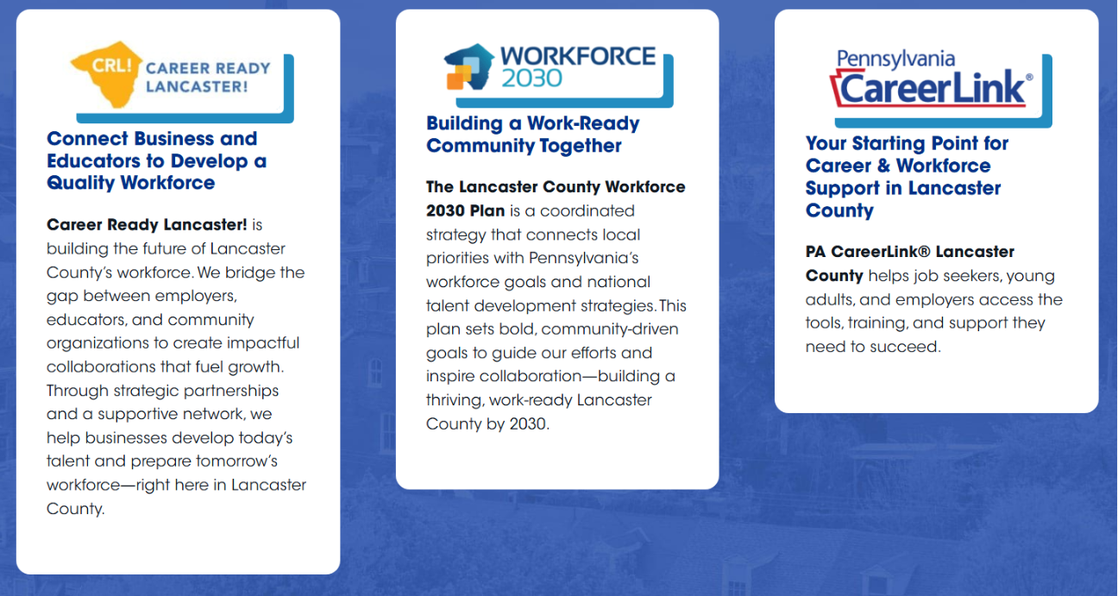


PARTNER WITH US
www.lancastercountywib.com

Slide 8



Slide 9
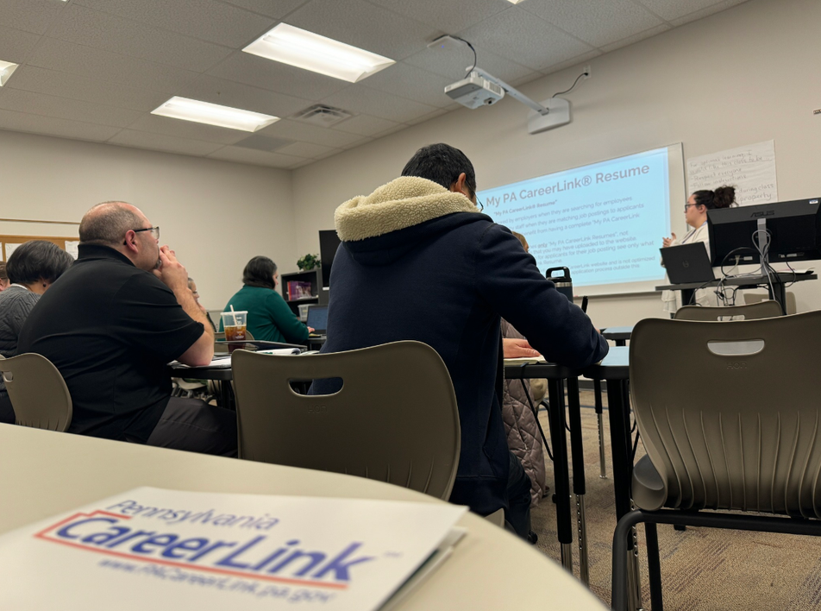
INTRODUCTION
PA CareerLink® Lancaster County’s mission is to assist and serve Pennsylvanians with finding self-sufficient employment. This could be through job searching, training, education, or other opportunities. We provide the tools to help job seekers find the skills and items they need to obtain employment.

Slide 10
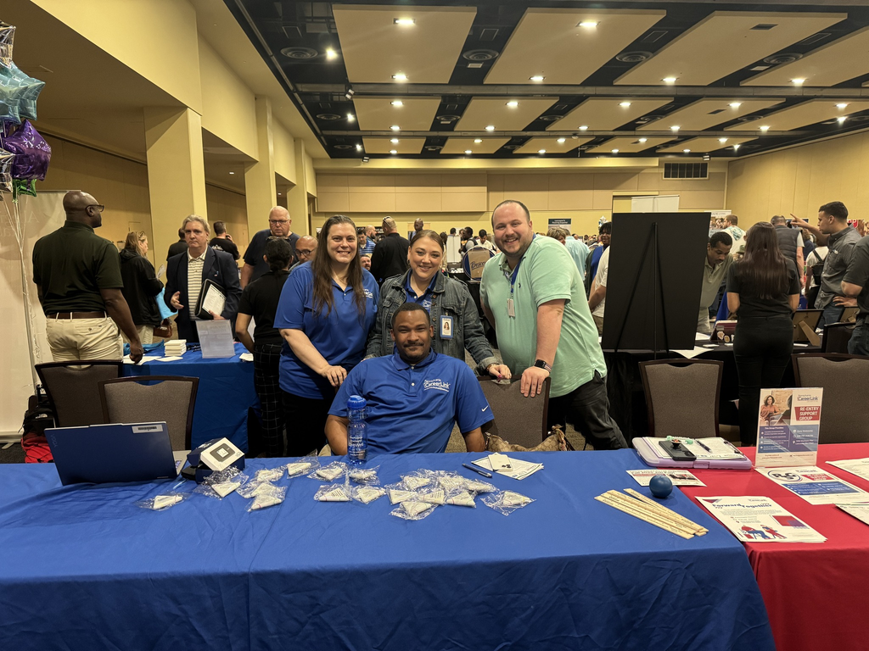
DEPARTMENTS
Adult and Dislocated Workers (WIOA)
Youth and Young Adults
Office of Vocational Rehabilition (OVR)
Veteran Services
Buisness Services

Slide 11
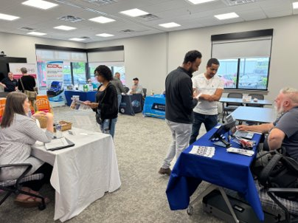
OUR SERVICES: SELF SERVICE
There are options for job seekers to job seek for opportunities on their own. We have services available to the public such as our Career Resource Center, online job search through pacareerlink.org, and learning resources such as SkillUp, O*NET, and Big Interview! This is great for those who are self-starters and are eager to get started without assistance.

Slide 12
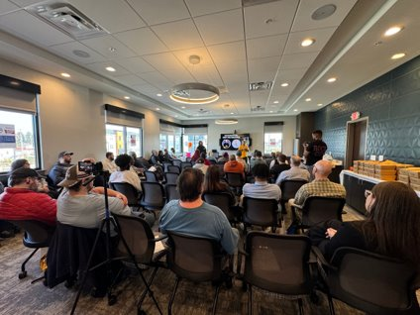
OUR SERVICES: ENAHNCED SERVICES
Our Enhanced Services are the next level up from Self-Service. This is a great option for those who have questions and need answers, want to enahnce job searching skills, learn better with help, and want to improve job search items such as resumes. These services include workshops, job fairs (and other events), mock interviews, and everything from self-service!

Slide 13
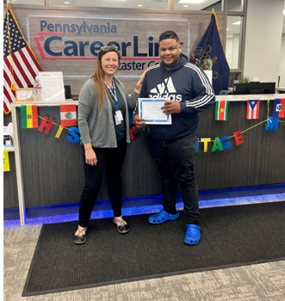
OUR SERVICES: PERSONALIZED SERVICES
These services are services that you have to apply to see if you are eligible for. These are a great option if you’ve been looking for work oin your own but have not been successful, underemployed, want help developing an employment plan, and if you need marketable skills. These services are available through both the Adult and Dislocated Worker Program and the Young Adult Program.

Slide 14
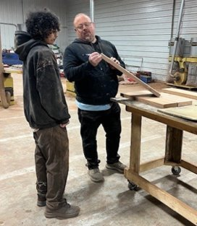
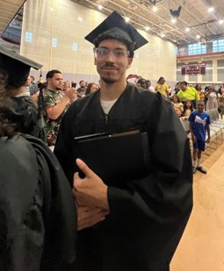
OUR SERVICES: PERSONALIZED SERVICES
THE PERSONALIZED SERVICES CAN INCLUDE:
One-on-One Employment Planning with a Career Navigator
Access ot the Career Connections Program & Networking Group
On-the-Job Training
Support Groups
Access to a Behavioral Health Advocate
Plus all the options from self-service and enhanced service

Slide 15
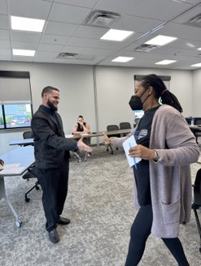
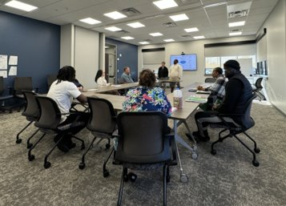
CAREER CONNECTIONS PROGRAM
Two-week intentsive job search course
Networking session with other job seekers
OPpportunity to practice job interview skills
Optimize marketable skills
One of the program elements you will go through when enrolled in the Adult & Dislocated Workers Program

Slide 16
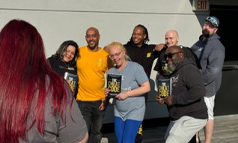
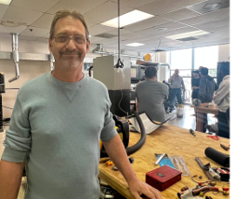
ADULT AND DISLOCATED WORKER PROGRAM
This program serves adults 18 years or older who are either; justice-impacted, low-income adults or laid off due to general downsizing, plant closures, the economy, etc., and have applied for, are collecting, or have exhausted unemployment compensation.
A Career Navigator will determine your eligibility for the Workforce Innovation and Opportunity Act programs and services.

Slide 17
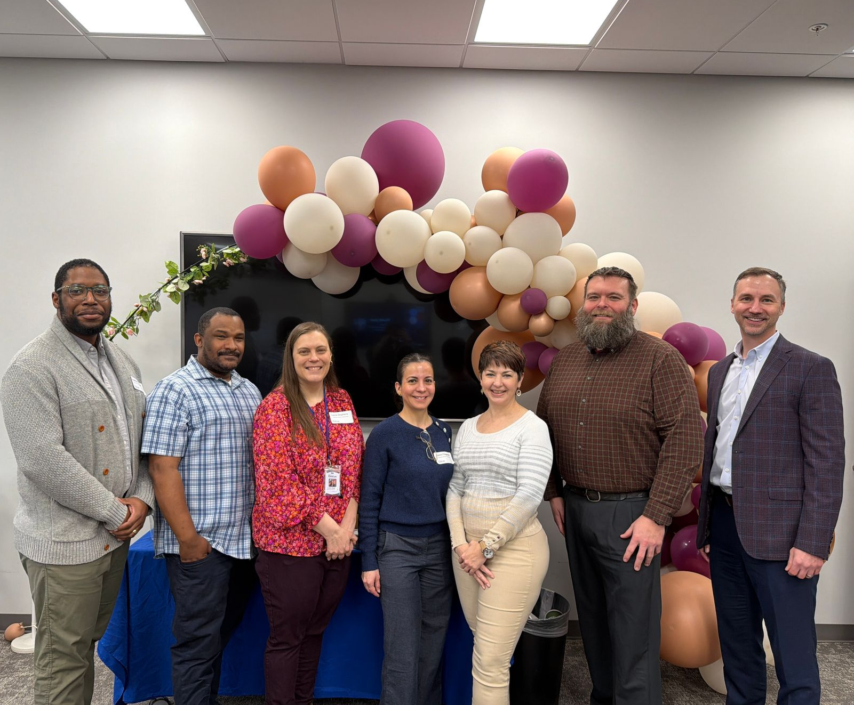
BUSINESS SERVICES
Job Posting
Job Matching
Candidate Pre-Screening
Apprenticeships
Recruiting Events & Fairs
Paid Work Experience
Employer Workshops

Slide 18


THANK YOU
Auxiliary aids and services upon request to individuals with disabilities. Equal Opportunity Employer/Program. Language service available free of cost.
TTY: (717) 391-3570 Program funded with federal dollars. For detailed information see https://tinyurl.com/4nhbzmft

Slide 19
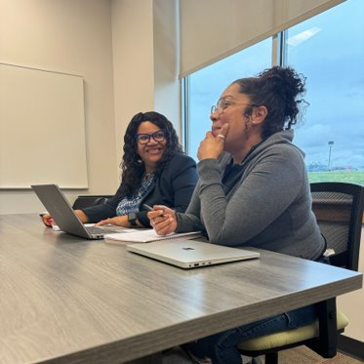
WIOA SERVICES
Assessments
Job Search Assistance
On-the-Job Training
Apprenticeships
Classroom Training
Case Management
Follow-up Services
Resources
Support Groups
Job Search Mentoring
Job Connection
Behavioral Health Services
Advocacy

Slide 20
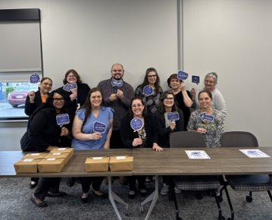
BHA SERVICES
Behavioral Health Advocates (BHAs) are Master’s-level professionals who specialist in mental health and provide brief supportive counseling. BHAs address stressors and barriers, listen and offer support, link clients to community resources, and help people achieve their goals.
PA CareerLink® Lancaster County’s BHA is available to all clients who need temproary services during their enrollment period.

Slide 21
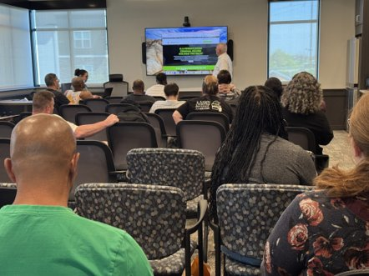
SUPPORT GROUPS
We offer two types of support groups for our clients and the job-seeking public.
RSG (Re-Entry support Group)
Forward Together (BHA Support Group)

Slide 22
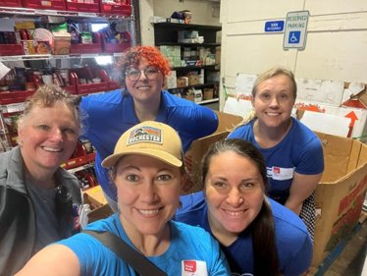
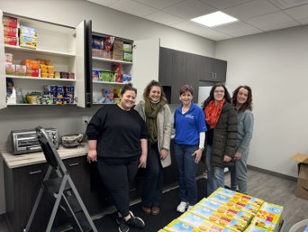
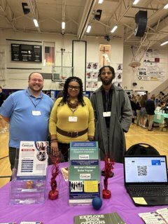
WE ARE HERE TO HELP

Slide 23
THANK YOU
Auxiliary aids and services upon request to individuals with disabilities. Equal Opportunity Employer/Program. Language service available free of cost.
TTY: (717) 391-3570 Program funded with federal dollars. For detailed information see https://tinyurl.com/4nhbzmft

Slide 24
THANK YOU
And please stay in touch
Aramos@lancastercountywib.com

